Slide 1
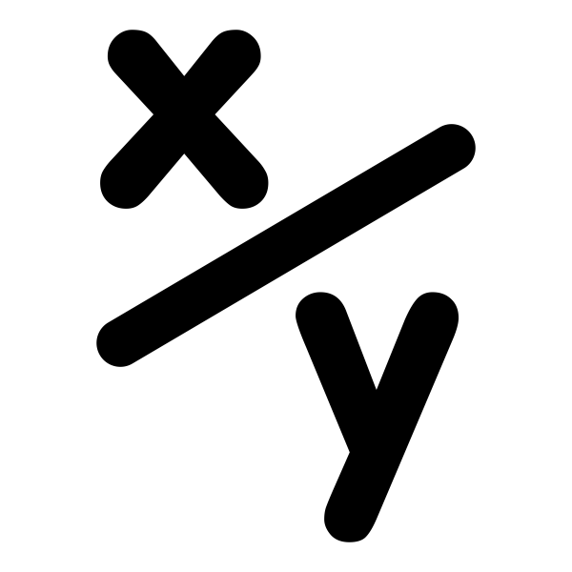
Variables and Flow Control in Python
ENGR 96A: Python and Machine Learning

Slide 2
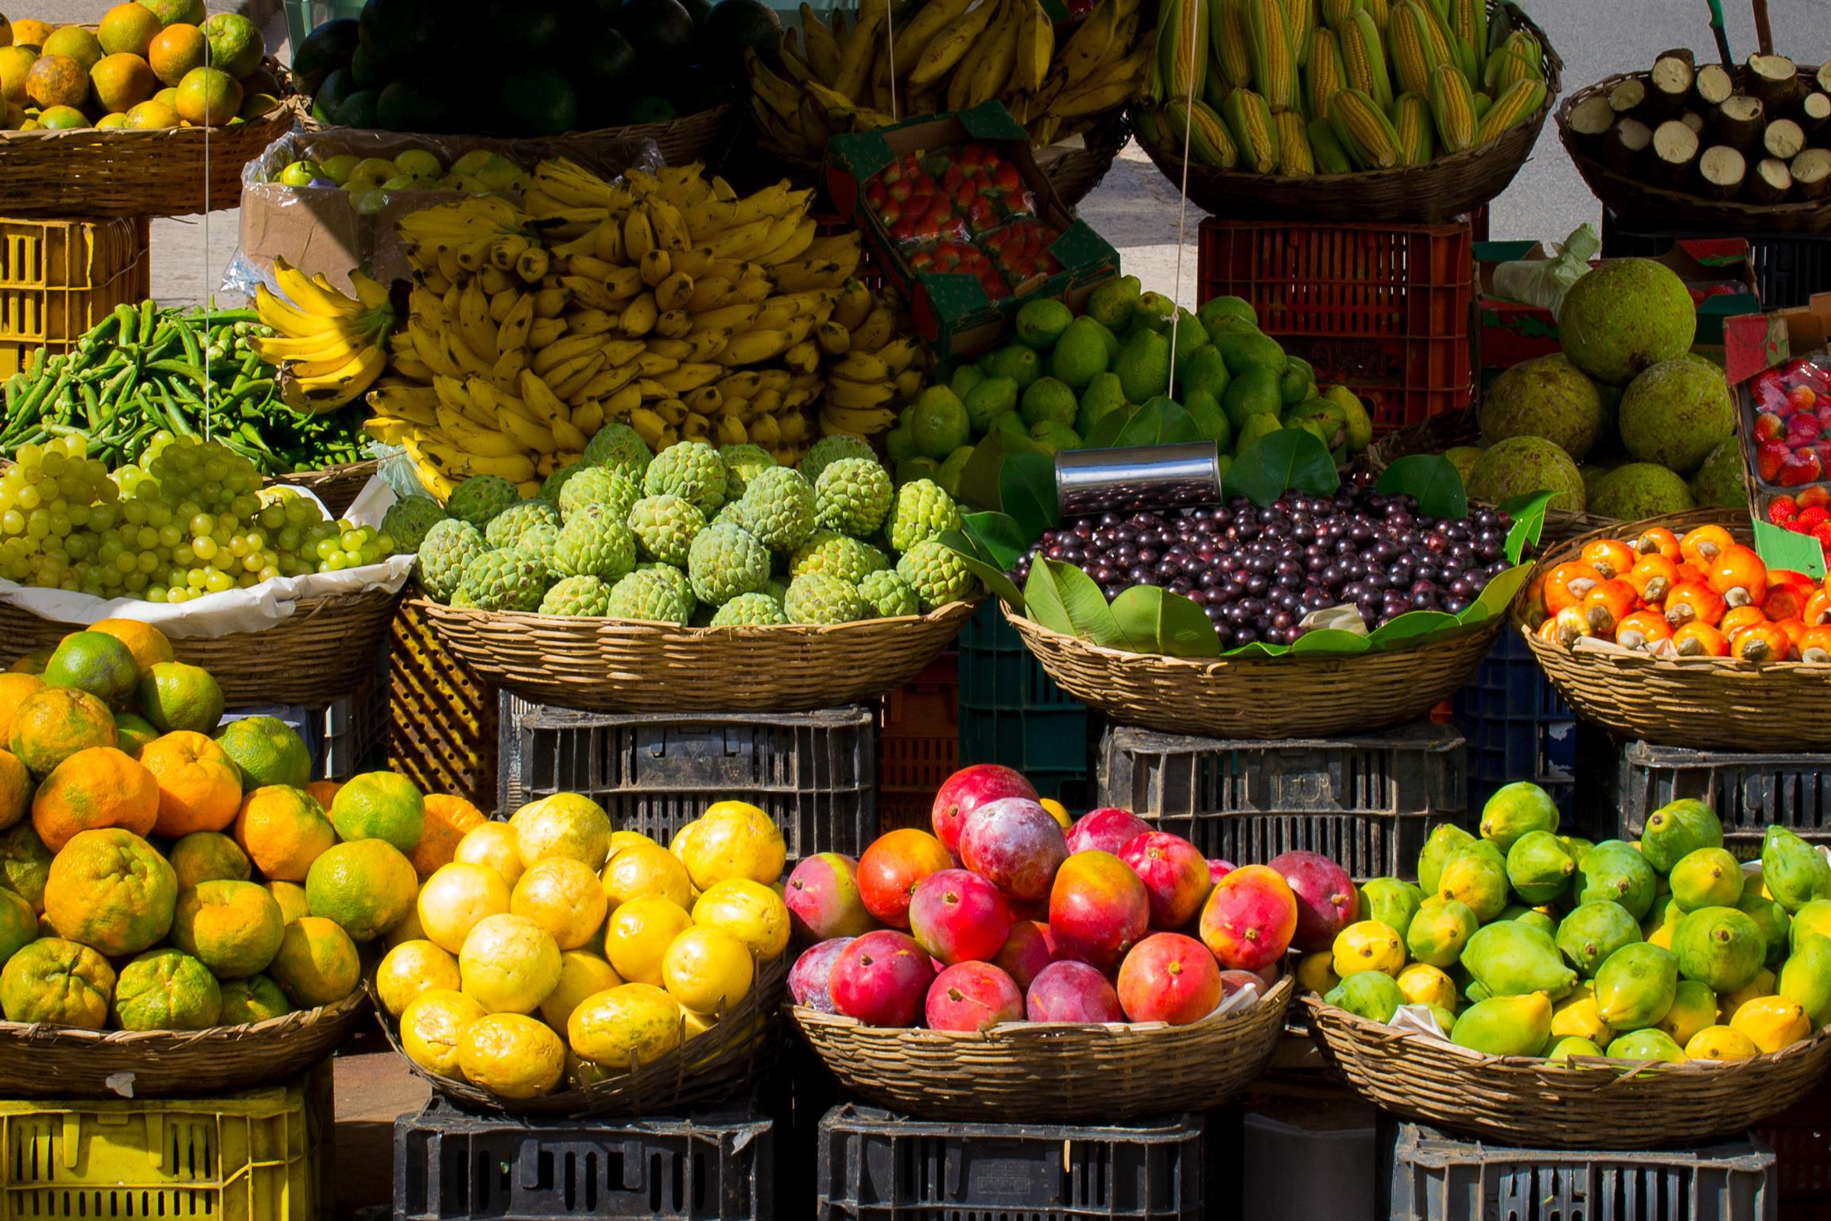
Variables
In Python, we can store things in variables for use later
Example:
What is the value of c?
Naming variables:
Variables cannot contain spaces
Generally, variable names should be related to what they contain
a = 5
b = 7
c = a + b

Slide 3

Data Types
We can store different types of data in our variables
Simple data types
int - integers
float - can include decimal numbers
char - single letters
boolean - True or False
Python is dynamically typed, meaning we don’t need to specify the data type when we create a variable

Slide 4
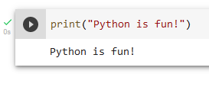
Data Types - Strings
Strings are blocks of text
Example: “Python is fun!”
We saw “Hello world!” earlier. This is an example of a string
How would you save this string in a variable named s?
How would you print this variable out to the console?
Notes:
s = “Python is fun!”

Slide 5
Data Types - Lists
Lists are collections of items
These items can be of multiple data types!
To access individual elements of our list, we must index into it
Lists are zero-indexed, meaning the first element is mapped to the index 0
Duplicates are allowed
a = [1, ‘a’, True, 2.3]
a[0]: 1
a[1]: ‘a’
a[2]: True
a[3]: 2.3

Slide 6
Data Types - Dictionaries
Stores data in key:value pairs
Items in a dictionary are:
ordered - items have a defined order
changeable - we can change, add, or remove items
unique - duplicate keys are not allowed, but duplicate values are
Can have multiple data types
We can index into a dictionary using its keys
myCar[“make”]: “Honda”
We can also change or add values like this
myCar[“type”] = “Sedan”
myCar[“year”] = 2003
myCar = {
“make”: “Honda”,
“model”: “Civic”,
“year”: 2015,
“color”: “white”
}

Slide 7
Data Types - Sets
Sets store multiple items in a single variable
Syntax: setname = {“Royce”, “Powell”, “Boelter”}
Items in a set are:
unordered - they do not have a set location and can’t be indexed
unchangeable after set creation
unique - cannot have duplicates
Can be of multiple data types like lists
Determine length using len(setname)

Slide 8
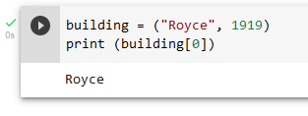
Data Types - Tuples
Tuples store multiple items in one variable
Syntax: tuplename = ("Royce", "Powell")
Items in a tuple are
ordered - meaning they have a set location and can be indexed
For example, tuplename[0] is the same thing as “Royce”.
unchangeable after tuple creation
not unique - can have duplicate values
Can be of different data types
Determine length using len(tuplename)

Slide 9
Data Types - Recap
For each of these:
Their length can be found with the len() function
They can store multiple data types
Data Type | Ordered? | Changeable? | Unique? | Example use case
List | Yes | Yes | No | Tracking cars seen on the road in order
Dictionary | Yes | Yes | Keys: Yes | Tracking the number of each particular model of car that we’ve seen
Set | No | Yes | Yes | Tracking the different models of cars that we’ve seen
Tuple | Yes | No | No | Storing the make and model of a specific car (faster than a list)

Slide 10


Input
You can also prompt for user input in the console.
Syntax is as follows: variableToSaveInputIn = input("Informational text")
Notice how the input is saved into a variable; this allows us to use the input later.
Additionally, the + operator can be used in a print statement to join multiple things together, in this case a string and a integer.
Notes:
Brianna end

Slide 11
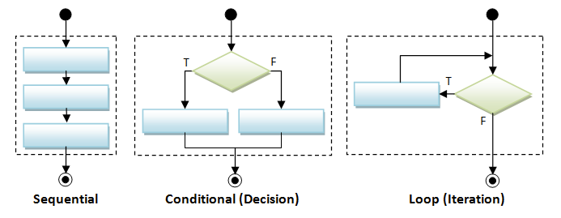
Flow Control
Commands in a Python file execute sequentially
We want alter this order using flow control statements
Flow control statements allow us to:
Execute different branches of statements depending on some criteria (if-else statements)
repeat a block of code a certain number of times (loops)
http://3.bp.blogspot.com/-8O3l5veDajk/VK8JFFUfcJI/AAAAAAAAAU4/OzY46kmpdMA/s1600/Flowchart_FlowControl.png

Slide 12

Flow Control - If-Else-Else if
These statements allow us to execute different code depending on specific conditions
(Notice how the end of each if/elif/else statement has a colon at the end!)
What will print if…
a is 12?
a is 7?
a is 0?
if (a > 10):
print("a is greater than 10")
elif (a > 0):
print("a is greater than 0 but less than or equal to 10")
else:
print("a is less than or equal to 0")

Slide 13
Flow Control - For Loops
For loops allow us to execute a piece of code a variable number of times
Can loop through all elements of a list
This will print every element in the list a
a = [1, ‘a’, True, 2.3]
for item in a:
print(item)

Slide 14
Flow Control - For Loops
You can also run a for loop for a set number of times using the range function
range takes three parameters:
start - integer specifying which number to start at (Default: 0)
stop - integer specifying which number to end at (non-inclusive)
step - integer specifying the increment (Default: 1)
Which numbers will print when the code above is executed?
for i in range(10):
print(i)

Slide 15
Flow Control: While Loops
A while loop will execute a block of code while a condition is true
What numbers will the above code block print?
i = 0
while i < 10:
print(i)
i += 1
check
increment

Slide 16
Challenge: divisible by 7
Create a cell in your notebook that prints out all numbers that are divisible by 7 between 1 and 100
Use loops and conditional statements
Hint: the modulus operator (%) will return the remainder of a division
Note: == tests equality
a = 1
b = 1
a == b

